Slide 1



AI Powered Chatbot
Providing financial advice
Tanhat Hussein Sabah Khan Miranda Garcia Perez James Cole Luis Rodriguez Valido
Yoonhee Lee Lewis McFarlane Kian Doyle Christopher Rayner Oliver Webb
Notes:
Welcome everyone. Thank you so much for coming to the office today. We are very excited to show you our project which we have been working on for the past 2 weeks. We focused on building an artificial intelligence powered chatbot which can provide financial advice to anyone. From a student that is just starting to manage their finances to someone looking to buy a house or stocks.

Slide 2
Agenda
01. Our team
02. Introduction and scope
…
…..
03. Project plan
04. Sprints
05. Final product and demo
-----
….
----
Notes:
Today we will be presenting our team and departments, we will introduce the project into more detail, we will go through the designed project plan, the sprints structure from each department and the final product with an interactive demo.

Slide 3










Meet Our Team
Business team
Data engineering team
Tanhat Hussein
Sabah Khan
(PMO)Miranda Garcia Perez
Luis Rodriguez Valido
Yoonhee Lee
DevOps team
Development and testing team
James Cole
Lewis McFarlane
Kian Doyle
Christopher Rayner
Oliver Webb

Slide 4

Scope
Develop an AI-powered Chatbot MVP for a financial institution. It will handle FAQs and provide basic financial advice, integrated with financial databases and APIs for real-time data.
The chatbot will be deployed on a cloud service platform (AWS) for scalability and reliability, ensuring compliance with data security and privacy regulations.
Basic user documentation and training will be provided.
Detailed project plan and requirements documentation.
Chatbot conversation flow and integration design.
Developed and tested application.
CI/CD pipelines.
Notes:
Today, we are presenting a project aimed at developing an AI-powered chatbot MVP for a financial institution. This chatbot will enhance customer service by handling common customer inquiries and providing basic financial advice, helping users make better informed decisions. This chatbot will also be deployed on a cloud service provider for reliability and scalability as well as ensure compliance with data security and privacy regulations.
The key deliverables agreed upon with the client included a comprehensive project plan covering the development phase, chatbot conversation flow, integration design, and deployment all within a two-week timeline. We also outlined project milestones and testing procedures to ensure successful delivery. a brief overview of how we approached our deliverables
We held regular meetings with the client and implemented CI/CD pipelines throughout the development of the project. This approach helped us simplify the requirements gathering process and build a strong working relationship with the client. This way we were able to collaborate closely, using techniques surveys and interview-style questions, We’ll discuss this further when we present our user stories later in the presentation now I’ll pass over to ollie who will talk about how we delivered on this project from a more technical stand point

Slide 5
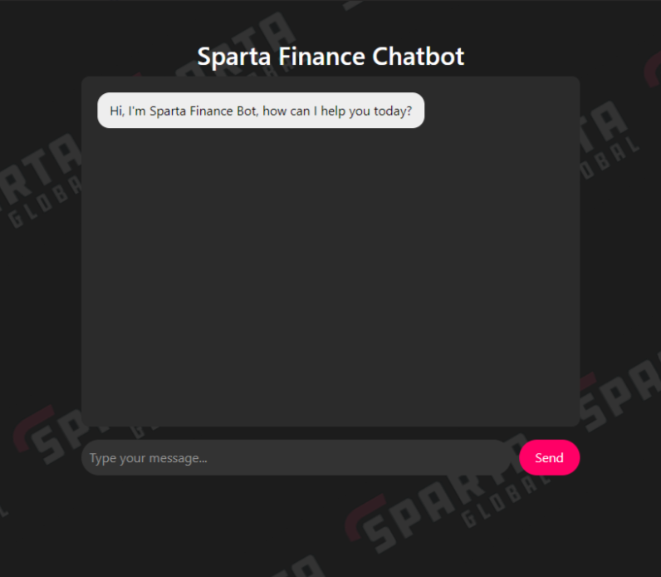
Introduction
Multi-Cloud & 3-Tier Architecture:
Presentation Tier
Application Tier
Data Tier
Notes:
"We’ve all been there. You need a quick answer about your finances –
But what if you could get Reliable & Accurate advice, instantly.
“I give you...
Presentation – the web-based interface
Application – business logic, handles user requests and facilitates communication - database & OpenAI API.
Data - hosts FAQ database - separate EC2 instance,

Slide 6
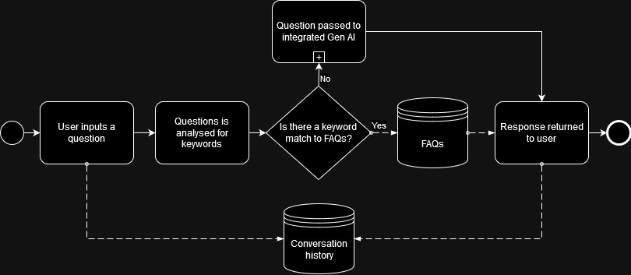
Notes:
The chatbot was designed to identify keywords
to query the FAQ- relevant responses - provide fast & accurate responses.
For user questions that cannot be matched, the integrated OpenAI API - utilised to expand the scope
Ensures comprehensive coverage of user questions and maximizes customer service.

Slide 7
Plan for product launch
Building the data base
Test
Design
2
1
5
Planning and research
3
Launch
3
4
Notes:
Thank you for giving us an overview of the project. Now we can focus on the plan that allowed us to complete this project effectively and on time. The first two days we gathered documentation, planned and researched the requirements. During the next few days the team carried out three sprints with continuous project directing where we built the data base, designed the chatbot and tested it several times. Once we felt confident about our final product we reviewed it and created this PowerPoint to present it to you ☺

Slide 8

User Stories
As a recent college graduate, I want to be able to ask for basic saving tips, so that I can learn how to build my savings early in my career.
Acceptance Criteria 1
Scenario: Asking for basic saving tips
Given I am a on the chatbot web app
When I ask the chatbot for basic saving tips
Then I should receive a list of saving tips
And the tips should be actionable and easy to understand.
Acceptance Criteria 2
Scenario: Chatbot is given a non-financial query
Given I am on the chatbot web app
When I ask the chatbot for information not related to finance
Then I will be prompted that the Chatbot is for finance related questions only
And prompted to enter a new query
Acceptance Criteria 3
Scenario: Admin can find previous conversations
Given I am on the chatbot web app
And I want to recall a previous question I've asked the chatbot.
When I access the valid admin endpoint
Then I can see all the previous conversations
Notes:
Miranda -> Chris User stories created from business objectives received from business team No. User stories: Entire Backlog full of user stories
User stories given in typical format as showcased with example here
Or As a business analyst, I would like to be able to track the conversations with the chatbot, to get a better idea of what questions are being asked more frequently.
Acceptance criteria created from user stories
Gherkin format Given/When/Then
Happy and sad paths – give quick example of each
Acceptance criteria invaluable for later deciding what to base test cases on.
Chris -> Miranda

Slide 9
Business Team Responsibilities
Sprint 1: Business Requirements Gathering
Key Deliverables:
Requirements Documentation: gather documents, ensuring alignment with the project scope.
Stakeholder Interviews: understand the stakeholders’ needs and expectations for the financial chatbot.
Initial Validation: Present the gathered requirements to stakeholders for approval before moving forward.
Sprint 2: Stakeholder & Departments’ Collaboration
Key Deliverables:
Liaising between Stakeholders: facilitate communication between stakeholders and the development team.
Clarify Requirements: address questions the development team may have to ensure smooth progression of the development process.
Track Changes: document and communicate any changes or updates to requirements.
Sprint 3: Solution Validation and Compliance
Key Deliverables:
Review Business Needs: ensure alignment with the documented business requirements through testing and user acceptance reviews.
Closing project stage
Stakeholder Sign-Off: confirm final product and sign-off from stakeholders, ensuring the delivered solution meets business needs and compliance standards.

Slide 10
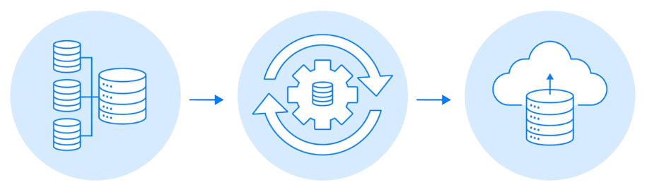
Data Engineering Team Responsibilities
Sprint 1: Schema Review and Setup
Sprint 2: Database Development
Sprint 3: Python Script Development
Key Deliverables:
Complete Question Bank:
50 FAQs including references.
Create Database Schema
Confirmation with Development Team
Key Deliverables:
Database Table Creation
Schema Improvement
Data Normalization
Key Deliverables:
ETL Pipeline Development:
Design and implement an ETL
pipeline using Python.
Database Integration:
Use SQLAlchemy to connect
with MySQL and automate the
ETL process.
Deployment:
Work with the DevOps team to
smoothly deploy and integrate
the ETL pipeline into production.
Notes:
The responsibilities of the Data Engineer team for the sprint 1 were to deliver
Complete Question Bank with 50 FAQS, including their references and keywords so that the program can match user questions with the appropriate answer.
These were stored in google sheets that later were exported in csv files.
Among the key deliverables, we also created a Database Schema so that the development team could see the structure of our database and the relations between tables
We sought approval of this initial schema, which was the one that you can see on screen.

Slide 11
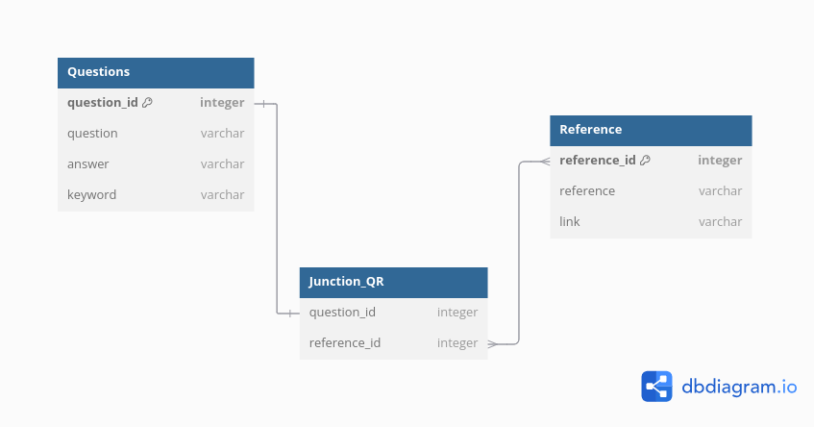

Initial schema
Notes:
This was our initial database schema, which was a simple one and just had a question table, reference table and a junction table to connect both.
After sharing the schema with the development team, we received feedback, and move on to our second sprint...

Slide 12
Data Engineering Team Responsibilities
Sprint 1: Schema Review and Setup
Sprint 2: Database Development
Sprint 3: Python Script Development
Key Deliverables:
Complete Question Bank:
50 FAQs including references.
Create Database Schema
Confirmation with Development Team
Key Deliverables:
Database Table Creation
Schema Improvement
Data Normalization
Key Deliverables:
ETL Pipeline Development:
Design and implement an ETL
pipeline using Python.
Database Integration:
Use SQLAlchemy to connect
with MySQL and automate the
ETL process.
Deployment:
Work with the DevOps team to
smoothly deploy and integrate
the ETL pipeline into production.
Notes:
The key deliverables for our second sprint were the schema improvement based on feedback.
This includes the data normalization and addition of new tables. Ultimately, the creation of the database with the desired tables and the data stored in this tables was also part
of our key deliverables for this second sprint.

Slide 13
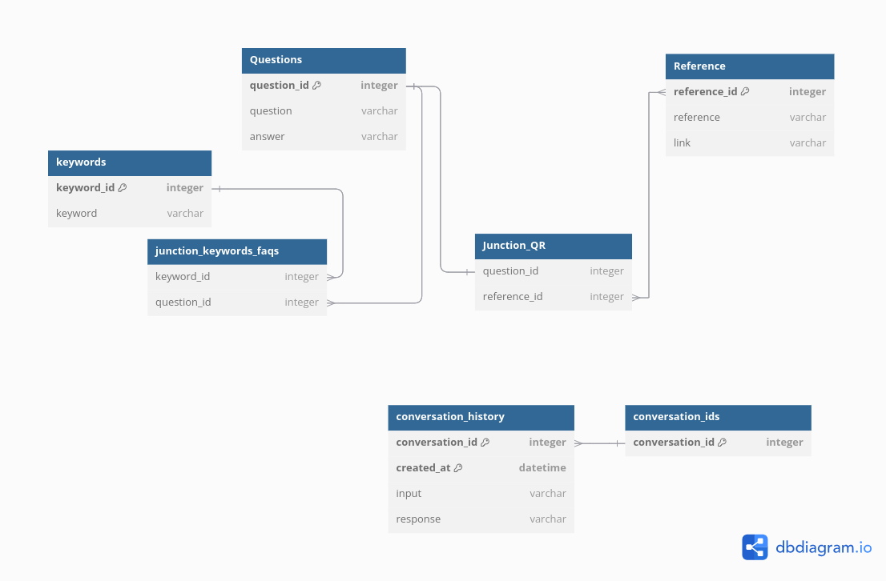
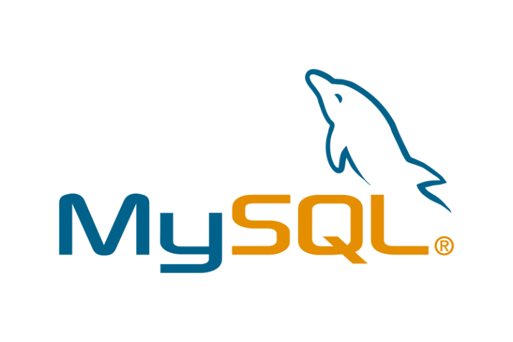
Final schema
Notes:
This is the final schema of our database. As part of the normalization process, we created a keywords table and junction table to connect this table with the question table. Additionally, we created conversation history and conversation ids table because the development team needed to keep track of the conversation and interactions that the users hold with the app.

Slide 14
Data Engineering Team Responsibilities
Sprint 1: Schema Review and Setup
Sprint 2: Database Development
Sprint 3: Python Script Development
Key Deliverables:
Complete Question Bank:
50 FAQs including references.
Create Database Schema
Confirmation with Development Team
Key Deliverables:
Database Table Creation
Schema Improvement
Data Normalization
Key Deliverables:
ETL Pipeline Development:
Design and implement an ETL
pipeline using Python.
Database Integration:
Use SQLAlchemy to connect
with MySQL and automate the
ETL process.
Deployment:
Work with the DevOps team to
smoothly deploy and integrate
the ETL pipeline into production.
Notes:
After we completed communication with the development team,
our next step was to work closely with the DevOps team.
As a data engineer, we created a Python script for the ETL
pipeline, ensuring integration with MySQL using SQLAlchemy.
This allowed us to automate the data extraction, transformation,
and loading process, all while collaborating with the DevOps
team for a seamless deployment
next slide :
- Extract data from CSV, Data transformation.
- Loading data into seven tables.
- Relational database successfully built

Slide 15
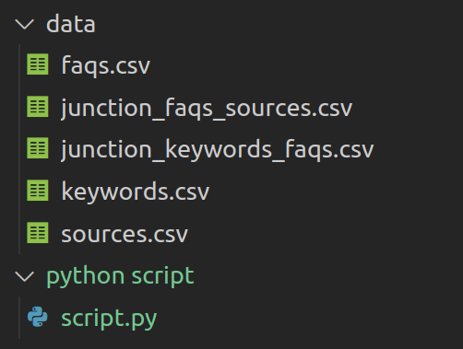
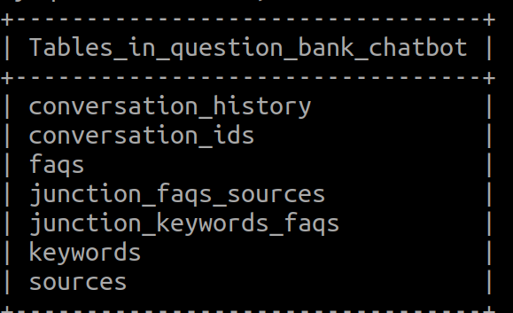
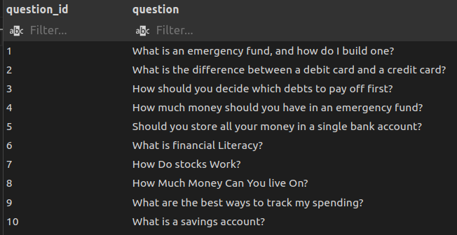


Result:
Extract data from CSV, Data transformation.
Loading data into seven tables.
Relational database successfully built
Notes:
After we completed communication with the development team,
our next step was to work closely with the DevOps team.
As a data engineer, we created a Python script for the ETL
pipeline, ensuring integration with MySQL using SQLAlchemy.
This allowed us to automate the data extraction, transformation,
and loading process, all while collaborating with the DevOps
team for a seamless deployment
next slide :
- Extract data from CSV, Data transformation.
- Loading data into seven tables.
- Relational database successfully built

Slide 16



DevOps Team Responsibilities
Sprint 2: Building
CI/CD with Jenkins:
Implement a Jenkins pipeline
Automate builds, tests, and deployments to ensure fast delivery.
Provision AWS Resources with Terraform:
Use Terraform to automate the provisioning of AWS infrastructure.
Write infrastructure-as-code (IaC) scripts for reproducibility and consistency.
Sprint 3: Deployment
Implement CI/CD with Testing:
Integrate automated testing into the CI/CD pipeline to ensure code quality.
Monitor deployment for issues, providing a feedback loop to the development team.
Connect AWS Resources with Azure AI:
Integrate AWS cloud services with Azure AI tools.
Ensure smooth data flow between AWS resources and Azure AI for real-time processing and analytics.
Sprint 1: Planning
AWS Architecture Planning & Design:
Design a scalable cloud infrastructure.
Choose appropriate AWS services for project needs.
Setting up Tools:
GitHub, Trello, Confluence

Slide 17
Developer Team Responsibilities
Sprint 1: Planning & Designing
System Architecture Diagram:
Define the overall structure of the application.
Control Flow Diagram:
Map out how data and control signals flow through the system.
Front End Wireframe:
Create a visual prototype of the user interface, outlining the layout and flow between screens, including key interactions and features.
Sprint 2: Implementation
Project Setup:
Set up version control, create environments and establish necessary tools.
Backend Functionality:
Implement core backend logic.
Front End Functionality:
Develop the user-facing elements
Code Coverage Unit Tests:
Write unit tests for code correctness.
Database Connection:
Ensure proper communication between the application and the database.
Sprint 3: Wrapping Up
Final Integration and Consolidation:
Bring all components (frontend, backend, database) together.
Hosting:
Confirm deployment of the application on a cloud platform or server, configure environments, and ensure it is accessible to users.
Hosted Database Connection:
Confirm and test a production-ready database.
Notes:
Three sprints
Sprint 1: Covers the planning and design phase of the project. With 2 whole days being dedicated to creating the class diagram, control flow diagram, and a frontend wireframe. Collaborating with the business team to corroborate our work.

Slide 18
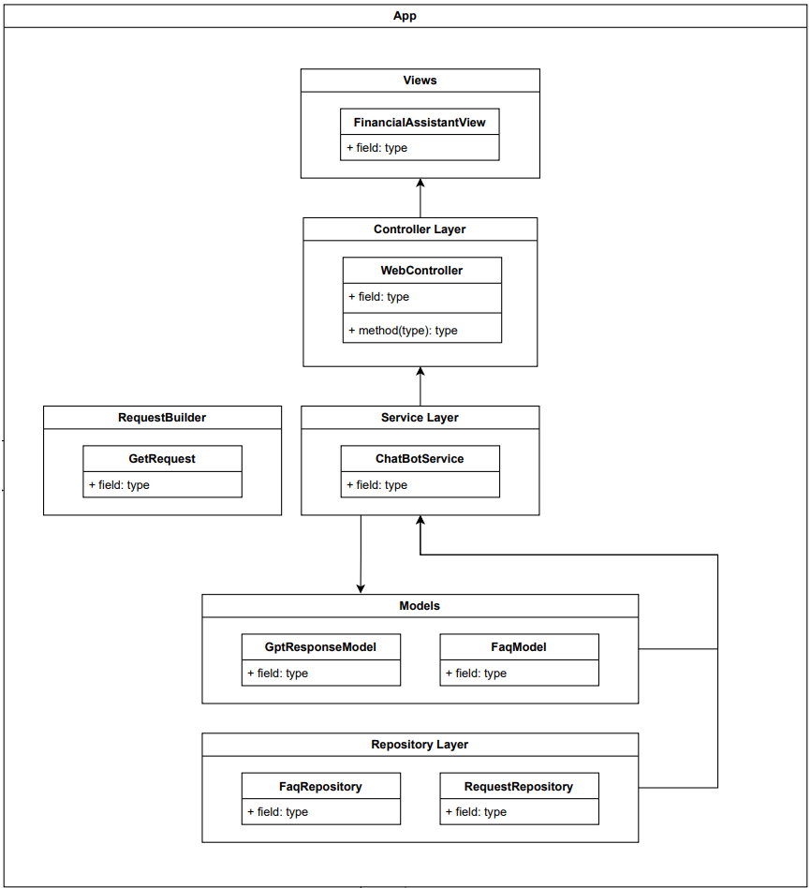

Slide 19
Developer Team Responsibilities
Sprint 1: Planning & Designing
System Architecture Diagram:
Define the overall structure of the application.
Control Flow Diagram:
Map out how data and control signals flow through the system.
Front End Wireframe:
Create a visual prototype of the user interface, outlining the layout and flow between screens, including key interactions and features.
Sprint 2: Implementation
Project Setup:
Set up version control, create environments and establish necessary tools.
Backend Functionality:
Implement core backend logic.
Front End Functionality:
Develop the user-facing elements
Code Coverage Unit Tests:
Write unit tests for code correctness.
Database Connection:
Ensure proper communication between the application and the database.
Sprint 3: Wrapping Up
Final Integration and Consolidation:
Bring all components (frontend, backend, database) together.
Hosting:
Confirm deployment of the application on a cloud platform or server, configure environments, and ensure it is accessible to users.
Hosted Database Connection:
Confirm and test a production-ready database.
Notes:
Sprint 2: Covers the implementation phase. 3 days dedicated to setting up the project, implementing the business logic (backend), the view (frontend), and unit tests for each service. Finally, we established a connection to the final MySQL database running locally.

Slide 20
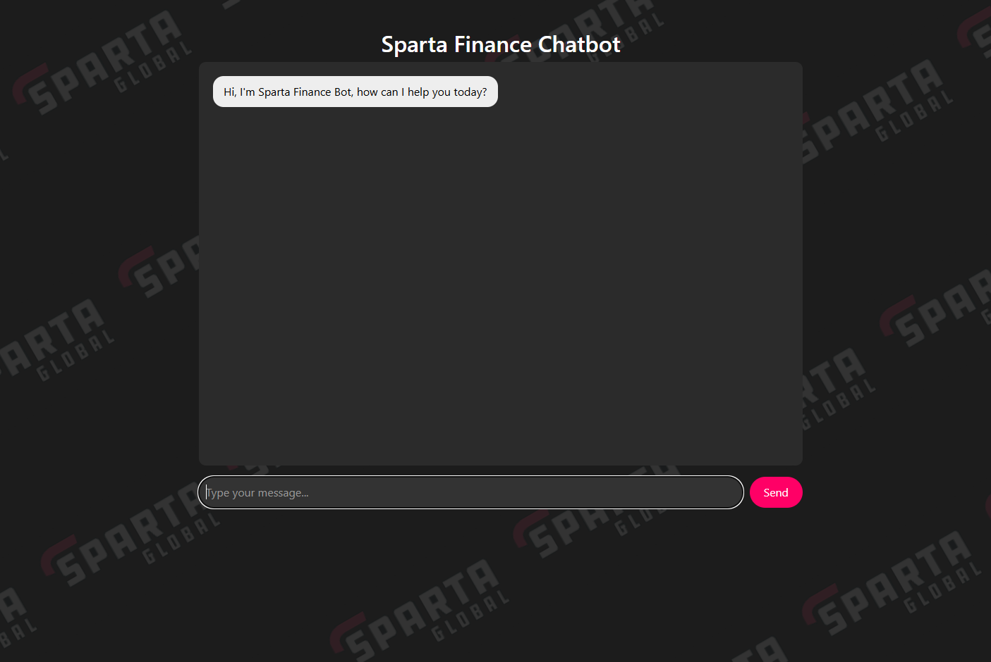

Slide 21
Developer Team Responsibilities
Sprint 1: Planning & Designing
System Architecture Diagram:
Define the overall structure of the application.
Control Flow Diagram:
Map out how data and control signals flow through the system.
Front End Wireframe:
Create a visual prototype of the user interface, outlining the layout and flow between screens, including key interactions and features.
Sprint 2: Implementation
Project Setup:
Set up version control, create environments and establish necessary tools.
Backend Functionality:
Implement core backend logic.
Front End Functionality:
Develop the user-facing elements
Code Coverage Unit Tests:
Write unit tests for code correctness.
Database Connection:
Ensure proper communication between the application and the database.
Sprint 3: Wrapping Up
Final Integration and Consolidation:
Bring all components (frontend, backend, database) together.
Hosting:
Confirm deployment of the application on a cloud platform or server, configure environments, and ensure it is accessible to users.
Hosted Database Connection:
Confirm and test a production-ready database.
Notes:
Sprint 3: Covers the final steps of the project - consolidation. We worked with DevOps and Data each to make sure that the final app and database was hosted correctly and was accessible by the app through a none local URL.

Slide 22
Testing Team Responsibilities
Sprint 1: Test Planning and Objectives
Focus: Establishing test objectives and acceptance criteria for user stories.
Activities:
Created user stories with corresponding acceptance criteria.
Developed the test plan to outline test scope, approach, and objectives.
Deliverable: Completed test plan.
Sprint 2: Development and Unit Test Coverage
Sprint 3: Exploratory & User Acceptance Testing
Focus: Completing development work with industry standard unit test coverage of service logic.
Activities:
Ensured all service logic has extensive unit test coverage.
Ongoing work to generate a unit test coverage report.
Deliverable: Unit test coverage report.
Focus: Perform exploratory and user acceptance testing based on the test plan.
Activities:
Created an exploratory test charter based on the test plan.
user acceptance testing using predefined criteria.
Deliverable: User acceptance testing results and exploratory test charter.
Notes:
Kian -> Chris
Development and Testing team one and the same – developers recently finished upskilling in automation testing
Wrote acceptance criteria for user stories
Test plan
Outlaying test objectives, scope, tools and environment, cases, recording of defects, and risks (gdpr user accessability etc)
Test plan part of the completed project delivarables.

Slide 23
Testing Team Responsibilities
Sprint 1: Test Planning and Objectives
Focus: Establishing test objectives and acceptance criteria for user stories.
Activities:
Created user stories with corresponding acceptance criteria.
Developed the test plan to outline test scope, approach, and objectives.
Deliverable: Completed test plan.
Sprint 2: Development and Unit Test Coverage
Sprint 3: Exploratory & User Acceptance Testing
Focus: Completing development work with industry standard unit test coverage of service logic.
Activities:
Ensured all service logic has extensive unit test coverage.
Ongoing work to generate a unit test coverage report.
Deliverable: Unit test coverage report.
Focus: Perform exploratory and user acceptance testing based on the test plan.
Activities:
Created an exploratory test charter based on the test plan.
user acceptance testing using predefined criteria.
Deliverable: User acceptance testing results and exploratory test charter.
Notes:
Mainly development work
Focused on applying best development practices like TDD
Using intellij coverage profiler to deliver a unit test coverage report

Slide 24
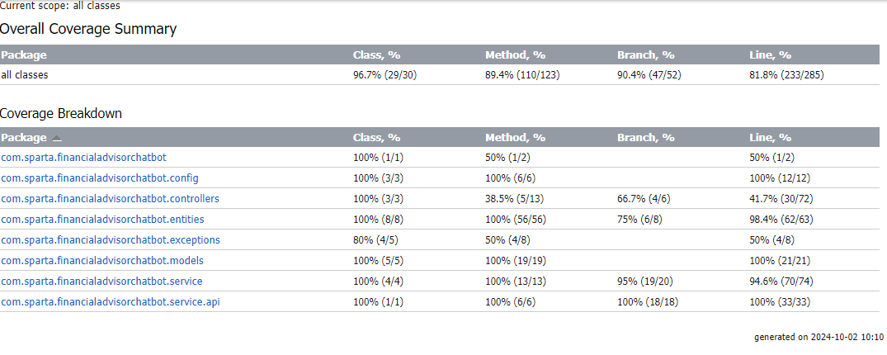
Coverage Report
Notes:
Industry standard according to google recommends 65% is a good start, with 80% being ideal
Achieved branch coverage of over 90.4% exceeding this goal.
Could chase 100% but exhaustive testing is impossible unless simple project, and as mentioned this project was anything but simple.

Slide 25
Testing Team Responsibilities
Sprint 1: Test Planning and Objectives
Focus: Establishing test objectives and acceptance criteria for user stories.
Activities:
Created user stories with corresponding acceptance criteria.
Developed the test plan to outline test scope, approach, and objectives.
Deliverable: Completed test plan.
Sprint 2: Development and Unit Test Coverage
Sprint 3: Exploratory & User Acceptance Testing
Focus: Completing development work with industry standard unit test coverage of service logic.
Activities:
Ensured all service logic has extensive unit test coverage.
Ongoing work to generate a unit test coverage report.
Deliverable: Unit test coverage report.
Focus: Perform exploratory and user acceptance testing based on the test plan.
Activities:
Created an exploratory test charter based on the test plan.
user acceptance testing using predefined criteria.
Deliverable: User acceptance testing results and exploratory test charter.
Notes:
User acceptance testing and Exploratory testing
Version of the final product was sent to stakeholders, for them to engage with, and to see if it met expectations. To mitigate absence of errors fallacy.
Defect reports – id, steps to reproduce, environment and date, passed to developers to fix defects found through failures.
Based on the scope of the project and time constraints, exploratory testing was deemed the best course, over an automated web testing framework.
Developed test charter based on items in the test plan

Slide 26
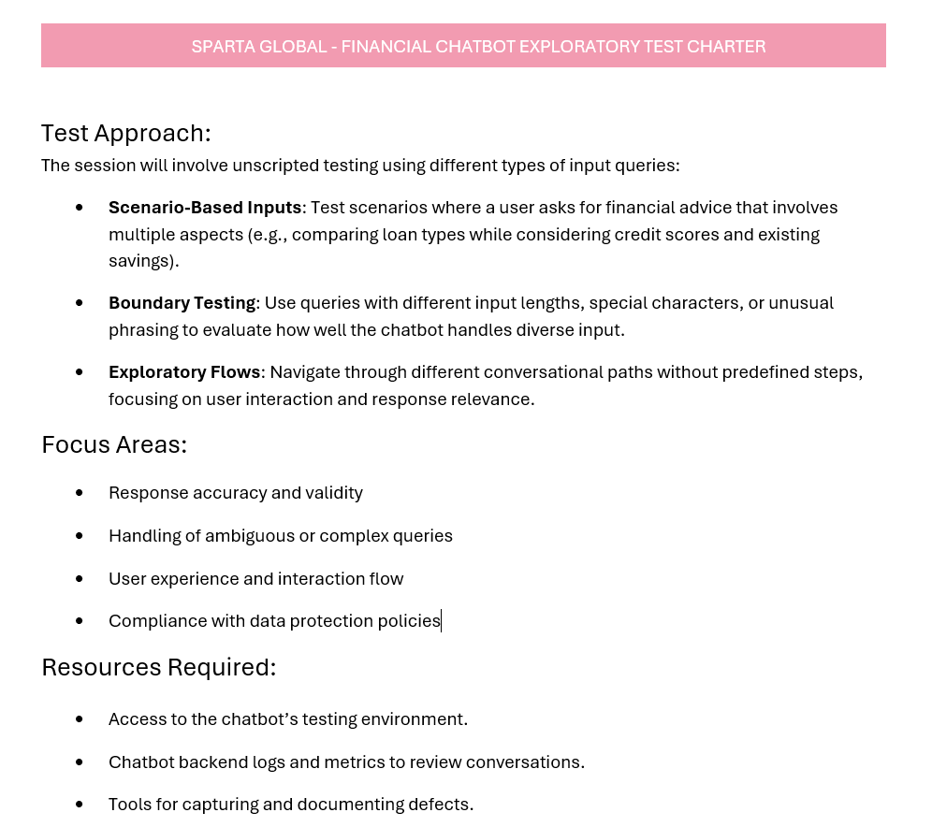
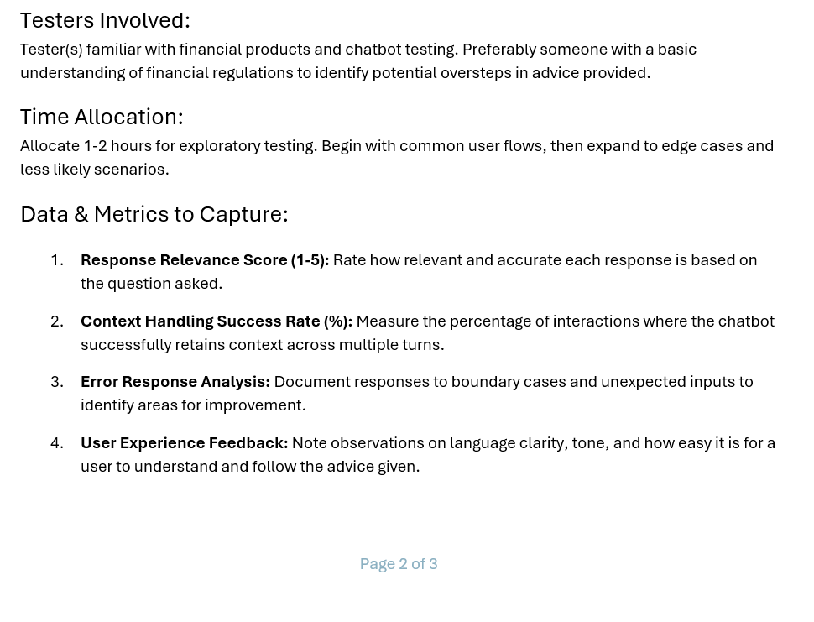
Exploratory Test Charter
Notes:
Showing exploratory testers areas of the product to focus their efforts on, and some high level examples of what to test.
Snapshot of the exploratory test charter, final product is part of the project deliverables.
Chris -> Sabah

Slide 27
RAID Log
RISKS | RISKS | ISSUES | DEPENDENCIES
R01:
Incorrect information from the chatbot.
Owner:
Data Team
Mitigation:
Use third party API
R03
I01:
Team changes slowing development.
Owner:
Development Team/Data Team
Mitigation:
Detailed documentation, agile methodology
D01
R04
D02
ASSUMPTIONS
D03
R02:
Scope Creep during MVP development.
Owner:
Business Team
Mitigation:
Define requirements and implement sprints.
A01
D04
A02
I02
D05
A03
Notes:
-Risks, Assumptions, Issues and Dependencies
-14 factors to consider – speaking about three which was highest priority.
- information was researched through FAQ’s and stored in our own database. and we used data from third-party APIs .
Cross checked for validity and relevance
-The stakeholder made it clear that the product was to only offer basic financial advice.
-Delivering small functional increments of product...
-We ensured all project details, requirements and decisions were documented thoroughly
-Practising short sprints allows the team to adapt quickly and reassign roles
-Daily Stand-ups - identify gaps caused by team changes.

Slide 28

Notes:
Intro lewis ☺

Slide 29

Summary
Leveraging Terraform tool to enable efficient, scalable, and automated deployments of a three-tier architecture across AWS and Azure.
After days of iteration, we have a working triple tier chatbot
Communication between teams and client was excellent and allowed us to work seamlessly
We met the deadline
We tackled technical issues efficiently in a timely manner
Notes:
In this project, we lever raged Terraform to enable efficient,
scalable, and automated deployments of a three-tier architecture
across both AWS and Azure.
although we had less than 2 weeks to work on this project we
successfully built a fully functional three-tier chatbot.
Our collaboration between teams and with the client was
Seamless.
we had lots of different opinions between teams but we
considered this as healthy relationship because having lots of
different opinion means we are considering many errors or risks
that could happen.
We also efficiently tackled any technical issues that occured,
ensuring the project stayed on schedule and we delivered
excellent results.
This is everything from Spartan, Thanks for listening and please let us know if you have
any questions. Thanks

Slide 30
Thank you Any questions?

